Slide 1
E-Book Application System Integration (E.A.S.I.)
Seraphim

Slide 2
Clients
Our Clients:
Ms. J’aimé Pfeiffer
Ms. Jen Cannell
Guests
Dr. Meg Fryling
Dr. Darren Lim

Slide 3
Introductions
Lauren Mathews: Team Leader
Daniel Street: Web Master
Nicholas Roth: Database Manager
Kevin Mango: Development Director
Tyler Carpenter-Rivers: Document Analyst

Slide 4
Problem Definition
Libraries need it to be easy for their students to access e-books
A single sign-on service for students to find all e-books given for their district

Slide 5
System Justification
One central location
Remove unnecessary complications
Too many vendors
Unique accounts

Slide 6
Project Goals
Simplicity
Single login for students
Maintenance by administrators
Access to multiple vendor sites

Slide 7
System Constraints
Younger students
Internet reliability
Programming languages availability

Slide 8
Project Functions
User groups
Add/remove vendors
Automatically checking vendors
E-Book acquisition
Administrators maintain system

Slide 9
Development Resources
Software: Adobe Photoshop, Oracle SQL Server, Eclipse, Google, Microsoft Office, Mozilla Firefox, SmartDraw
Languages: Java, SQL, CSS, HTML, JavaScript, PHP

Slide 10
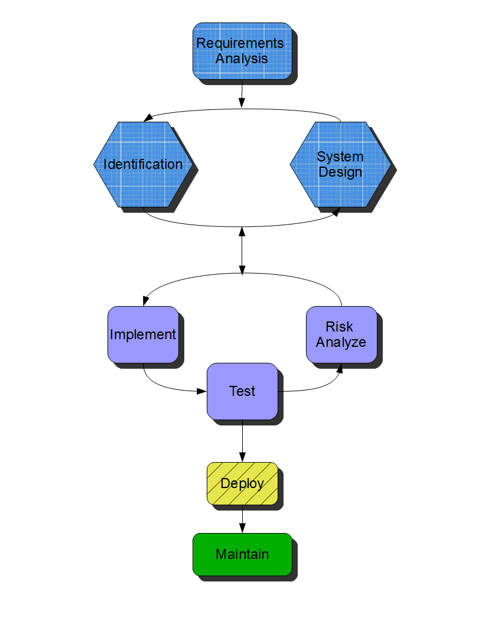
Spiralfall

Slide 11
Timeline
Task | Duration (Days) | Start | Finish
Establish Team | 2 | 9/3 | 9/4
Software Plan | 8 | 9/11 | 9/19
Software Plan Presentation | 3 | 9/20 | 9/23
Team Website Creation | 6 | 9/24 | 9/30
Requirements Specification | 23 | 10/1 | 10/24
Requirements Specification Presentation | 3 | 10/25 | 10/28
Data Dictionary | 12 | 10/29 | 11/10
Unit Tests | 15 | 10/29 | 11/13
UML Diagrams | 19 | 10/29 | 11/17
Preliminary Design | 10 | 11/18 | 11/28
Preliminary Design Presentation | 6 | 11/29 | 12/4
Client Meetings | ~ 20 | 9/11 | 12/2
Team Meetings | ~ 20 | 9/10 | 12/4

Slide 12
What’s Next?
Web Site
Requirements Specifications
System Design

Slide 13
Agenda
System Definition
Problem Definition
System Justification
Project Plan
Project Functions
Environments
Project Goals
System Constraints
Model
Timeline
What’s Next

